Slide 1
Tenant Opportunity to Purchase
Pilot Program—April 2026
Policy, Planning, and Implementation Bureau
Chicago Department of Housing
Notes:
-If we haven’t met before, my name is Ryan Cirillo and I work for the City of Chicago Department of Housing.
-Program Lead for the Tenant Opportunity to Purchase Act Pilot Program, or TOPA.
-I’m here presenting to you today because DOH wants to ensure that, as realtors, you understand TOPA and what’s expected of you if you ever find yourself in a TOPA transaction.
-So let’s go ahead and get started!

Slide 2
Goals
Inform attendees of the basics of TOPA
Provide an outline of TOPA transactions
Bring attention to the recent changes to TOPA
Leave time for questions
Notes:
-Basics such as where it applies, what the purpose is, and so forth.
-If you’re already familiar with TOPA, I want be sure that we’re keeping you abreast of recent programmatic changes
-My hope is that we will also have ample time for questions at the end.

Slide 3
TOPA Programs Overview
Purpose: To reduce displacement of low/moderate-income residents and provide wealth-building opportunities for tenants.
Two Programs:
  Tenant Opportunity to Purchase the Block (606) Pilot Program (Chapter 5-11)
  Tenant Opportunity to Purchase Jackson Park Pilot Program (Chapter 5-10)
The former program was created by the Northwest Side Housing Preservation Ordinance(2024).
The latter was created by the Jackson Park Housing Pilot Ordinance (2025).
Notes:
The Northwest Side TOPA was implemented in early 2025 to counter displacement and preserve affordability in rapidly-changing Northwest Side neighborhoods through expanding the opportunity for homeownership.
Jackson Park is highlighted because that program only began on April 6th of this year.
Both of these programs were part of ordinances that included a broader package of housing-related policy, such as the demo surcharge a debt relief program. Today, we will just focus on TOPA.

Slide 4
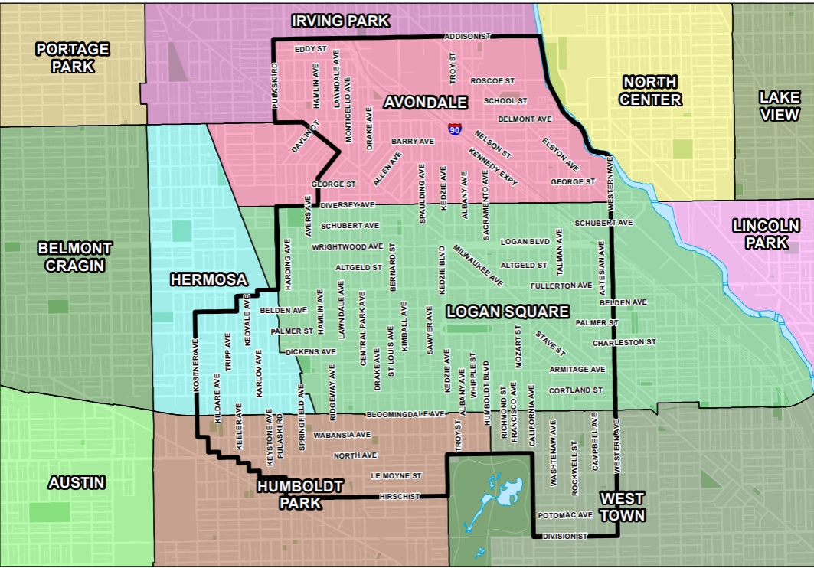
606 District
Notes:
These are the boundaries to the 606 Block District in the Northwest Side community areas of Avondale, Hermosa, Humboldt Park, Logan Square, and West Town
Please note that these boundaries are not inclusive of both sides of the street. So, for example, you’ll see that Addison Avenue is the northernmost boundary of the district– only properties on the southern end of Addison are in the district

Slide 5
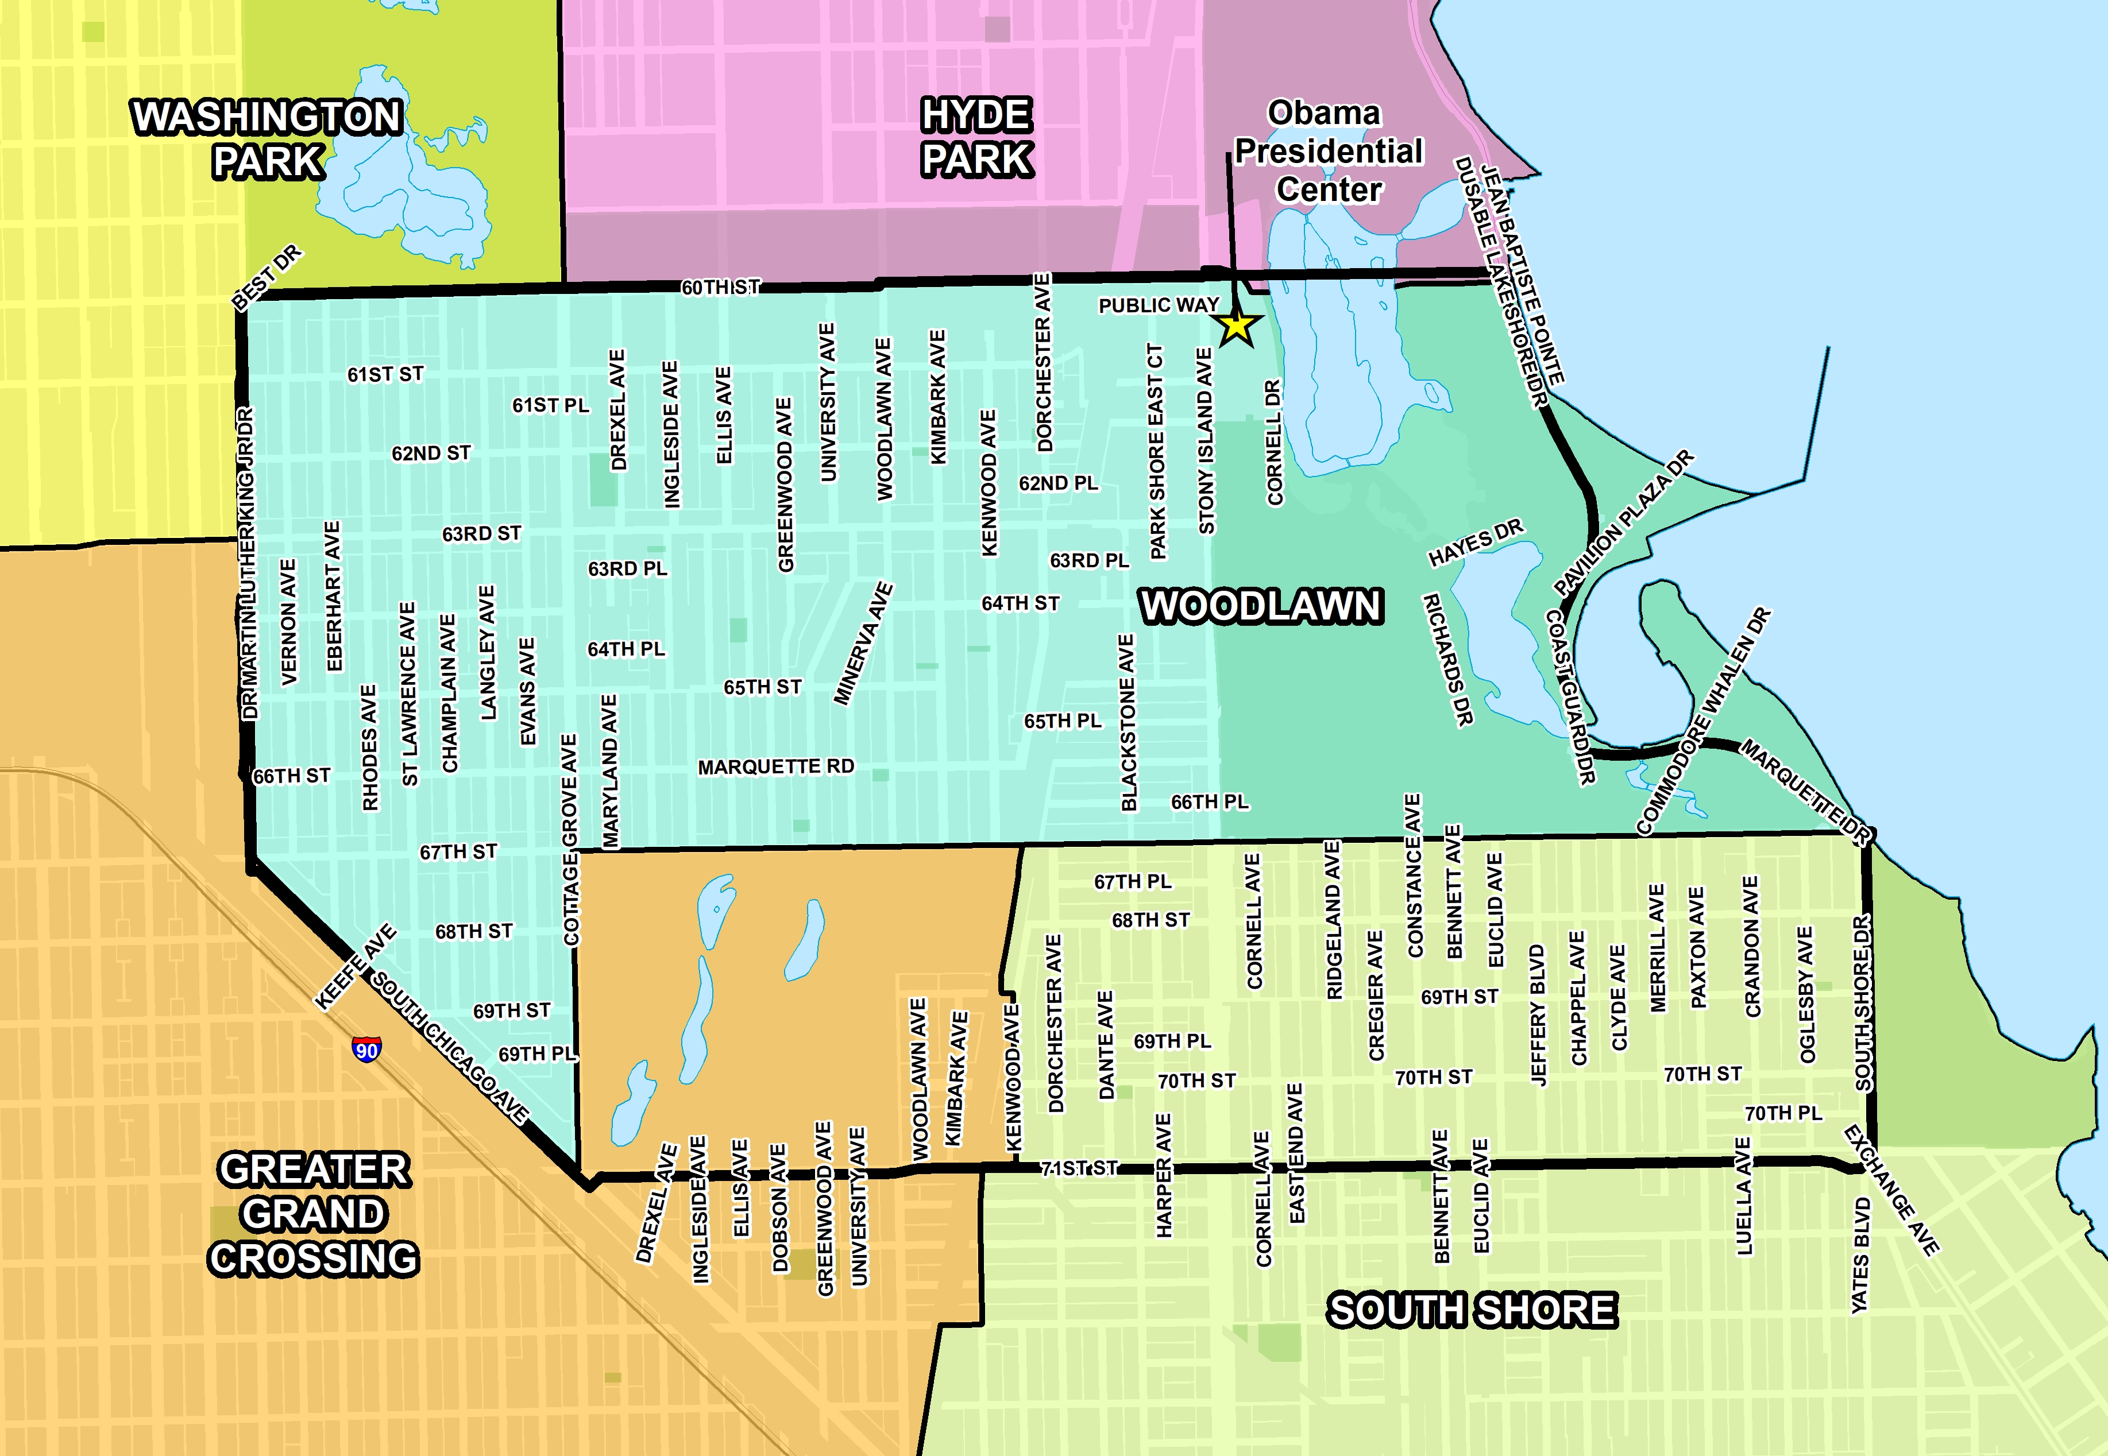
Jackson Park District
Notes:
You'll see here that the Jackson Park District include all of Woodlawn and parts of South Shore and Greater Grand Crossing. The district is bound by 60th/the Midway on the North, Martin Luther King and SOuth Chicago on the West, 71st on the South, and the lake shore on the East.
As with the last slide, these boundaries do not include both sides of the street.

Slide 6
Covered Properties
TOPA applies only to properties units currently occupied by residential tenants(as defined by the ordinance)
  Vacant properties, commercial properties, and properties that are only occupied by the owner are not covered by TOPA.
Beyond those three requirements, few properties within the 606 and Jackson Park districts are exempt from TOPA.
  Some notable exemptions include:
    CHA-managed buildings
    Buildings undergoing foreclosure or bankruptcy sales
    Buildings being transferred to an heir
    Full list of exemptions can be viewed in Sections 5-10-040 and 5-11-040 of the Municipal Code
Notes:
For a property to be covered by TOPA, it must be currently occupied by residential tenants.
If you want to see all of the exceptions, you can look in the ordinance.

Slide 7
TOPA/Right of First Refusal
Tenant Opportunity to Purchase grants tenants in rental properties the first opportunity to purchase the building from the landlord, known as the right of first refusal (ROFR).
Tenants are given an advance notice (30-60 days depending on number of units) of the owner's intent to sell before the listing of the property.
Tenants match a third-party purchase offer either as an individual or as a tenant association (if there are 3+ units in building).
Residents are then given a period to secure financing and close on the property.
Tenants can also transfer their ROFR to a third party (nonprofit, private owner) who can keep the building affordable.
Notes:
The right of first refusal is different from a typical tenant purchase because it means that, if the tenant or tenant association can match the offer that the owner intends to move forward with, the owner must sell to the tenant or tenants.
Tenants are given an advanced notice (30-60 days depending on number of units) of the owner's intent to sell before the listing of the property.
Residents must form and register a tenant association if their building has 3+ units to exercise their "right to first refusal."
Residents are then given a period to secure financing and close on the property.

Slide 8
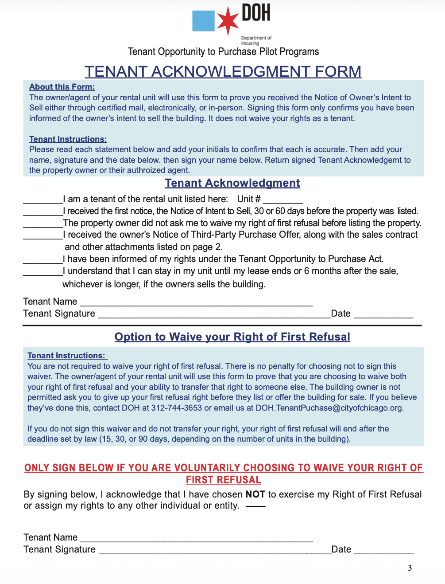
Waiver of Right of First Refusal
If a tenant waives their ROFR, they’re giving up their right to purchase the property they live in before the owner can offer it to someone else or transfer their ROFR.
If most housing units waive, the property owner can move forward with another offer.
ROFR can be reinstated– 10% rule, or new offer
Tenants can choose to waive their ROFR at any point, but landlords are not allowed to ask them to or coerce.
Notes:
-If the price of the property falls by 10% or more from the initial listing price, then the tenants’ ROFR is reinstated. This is because 10% is a substantial enough decline that tenants who may have initially felt the property was too expensive may find the new price feasible
-Also, if the property receives an offer that is presented to the tenants but subsequently falls through, the new offer must be presented to the tenants.

Slide 9
Key Program Improvements
Creating a more efficient submission process
Clarifying responsibilities of property owners and tenants to ensure program compliance from start to finish
Providing a resource guide for tenants interested in purchasing
Additional accommodations for non-English speakers
The ordinance itself has not changed, but the rules have been refined.
Notes:
We heard feedback from a number of stakeholders and are distilled that feedback into a key program improvements.

Slide 10
Notice of Intent to Sell
Provides notice of listing to tenants and shares details about the property to DOH
  New version is split into two documents—Notice of Owner's Intent to Sell and Owner Declaration. The former is given to each unit by property owner then sent along to DOH, and the latter is submitted directly to DOH from owner.
  Waiver was removed and added to the Notice of Third-Party Purchase Agreement(though tenants can still waive in writing at any time).
  Owner side now has attestations to ensure that owners understand program rules and are liable for following them.
Notes:
-The Notice of Owner’s has two functions.
-The Owner Declaration of Intent to Sell provides DOH information about the property, including the number of housing units. This helps us to establish timelines for the transaction.
-Tenants can waive their right of first refusal on a written affidavit, or you can also use the waiver page on the Third-Party Purchase Agreement.

Slide 11
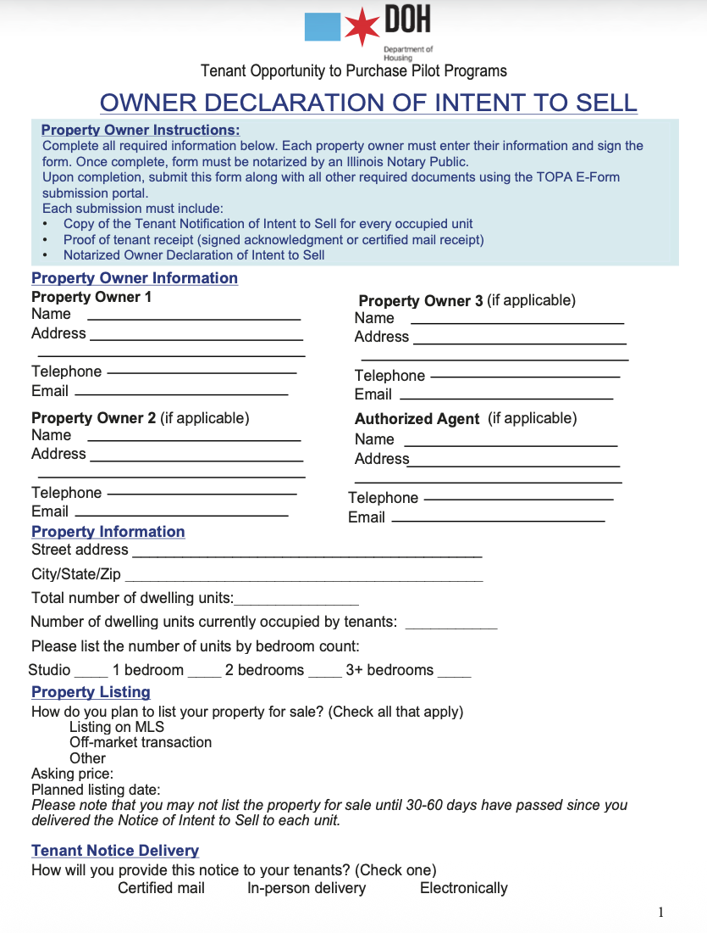
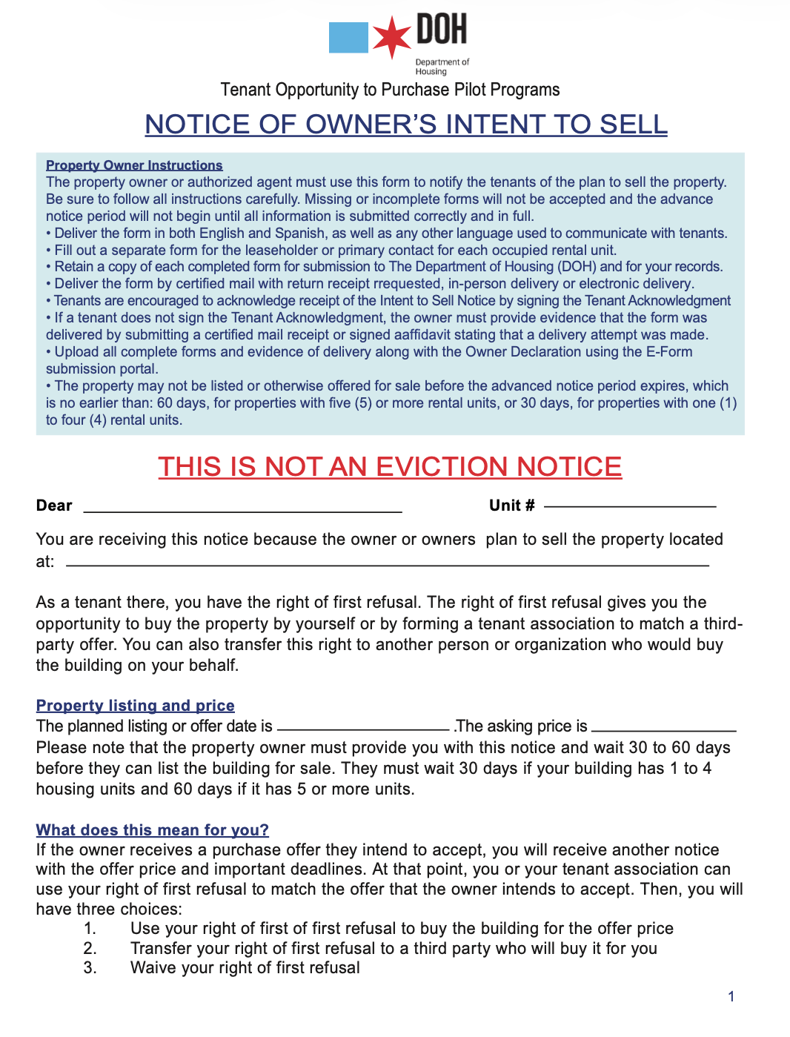
Notes:
Both documents now have instruction guides at the top, and the tenant side has a resource guide if they're interested in purchasing.
-

Slide 12
Notice of Third-Party Purchase Agreement
Informs each unit of the terms of the third-party purchase offer.
  Must be provided alongside a copy of the offer and any financial disclosures requested by tenants.
Instructions are now listed at the top
The waiver has been moved to this document
If the tenant or tenants in a unit do not respond to this notice after 15/30/90 days (depending on building size), their ROFR is considered waived.

Slide 13
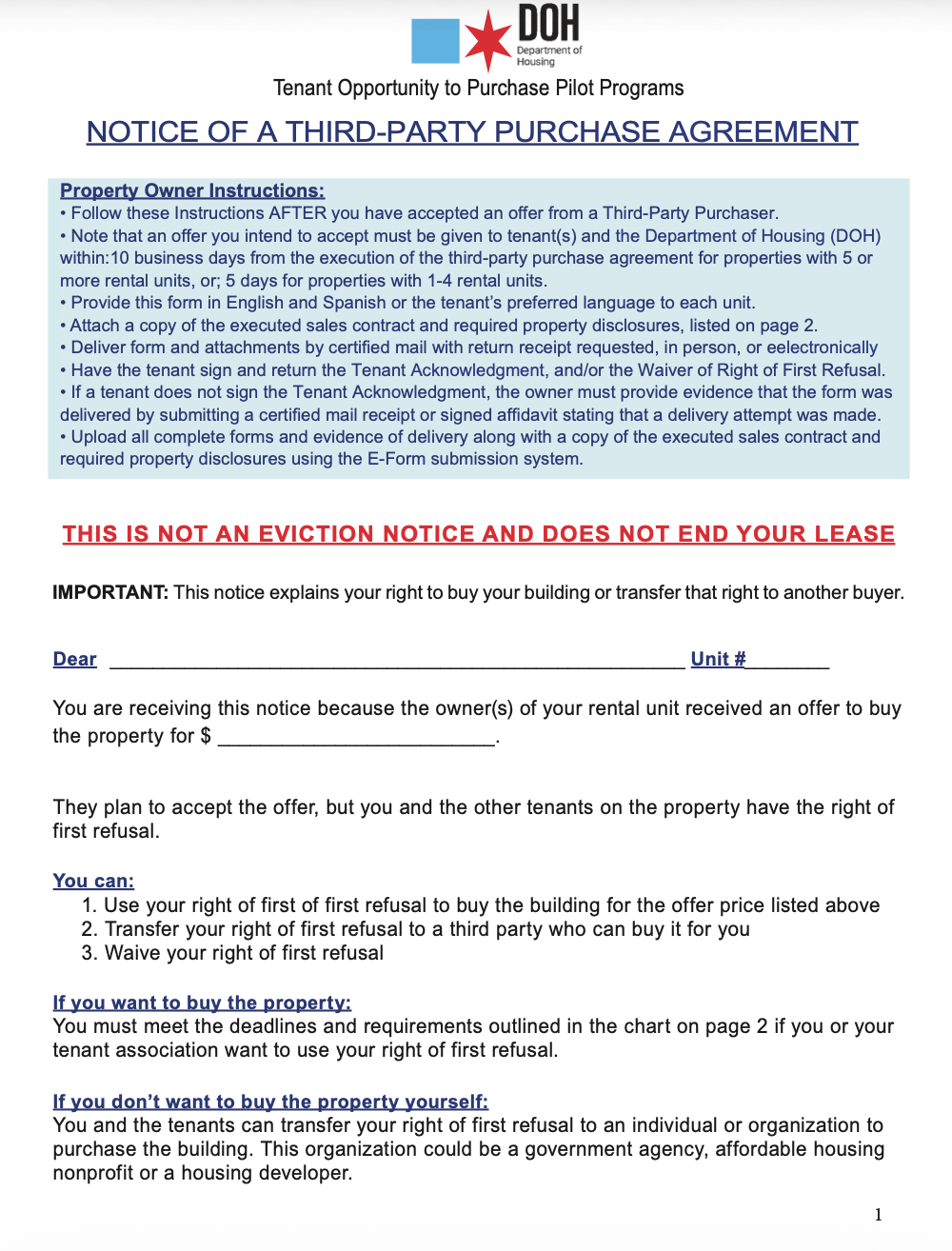
Notes:
-Instruction box at the top
-Information for the tenant about their options: waiving, exercising, or transferring
- the tenant acknowledgement form is where tenants indicate what they want to do with their ROFR and verify that the process was done correctly

Slide 14
Outline of TOPA Process
Give Notice of Owner's Intent to Sell to each unit 30-60 days in advance
List the property publicly when the 30-60 days expire
Offer is received, owner gives Notice of Third-Party Purchase Agreement, a copy of the sale contract, and financial disclosures to each unit
Tenants either exercise, waive, or transfer ROFR, providing necessary financial assurances if they exercise
Owner moves forward with tenant(s) or third-party purchaser
Notes:
-30 days if the property have 4 or less housing units
-When

Slide 15
E-Form Submission Portal
Replaces email as the primary submission medium for all documents.
  Benefits: easier documentation and data-collection, quicker responses
We are currently in a one-month grace period—submitting on portal will be compulsory by May 6th
  Exemptions considered on a case-by-case basis for people with limited technological literacy

Slide 16
Website Changes
The TOPA website contains all the forms needed to successfully complete the TOPA process as well as a link to the portal and other resources
We have also included additional information about the TOPA process on the website.
https://www.chicago.gov/topa

Slide 17
Expanded Language Access
Property owners must submit the following notices in both English and Spanish:
    Tenant Notice of Intent to Sell
    Public Notice of Intent to Sell
    Notice of Third-Party Purchase Agreement
Spanish forms are on the website in addition to other frequently spoken languages.
  Arabic, Chinese, French, Polish, and Tagalog.
  If a tenant speaks neither English nor Spanish, their timelines don’t start until they receive the documents in their preferred language

Slide 18
Additional Learning
Review Municipal Code of Chicago Sections 5-10 and 5-11.
All resources available at https://www.chicago.gov/topa including a one pager, FAQ, and timeline graphics for corresponding number of units.
Ambiguities in the ordinance are cleared up in the Rules document, which is on the website.
Questions about the Tenant Opportunity to Purchase Pilot Programs can be directed to DOH.TenantPurchase@cityofchicago.org
Notes:
Review Tenant Opportunity to Purchase Block (606) District Pilot Program Rules

Slide 19
Q&A

